Slide 1
About our example-documentation
collect/explore
summarize/apply
update
Documents required in our course:
Vision & scope document
Analysis model document
Software requirements specification
Notes:
Template / adapted it

Slide 2
Chapter 10: Documenting the Requirements Chapter 11: Writing Excellent Requirements

Slide 3
REVIEW: Requirements Engineering
Requirements Engineering
Requirements Management
Requirements Development
Elicitation
Analysis
Specification
Verification
Notes:
Wiegers, p. 19

Slide 4
Outline
Content and structure of SRS
Template of SRS
Guidelines for writing functional requirements
Examples of flawed requirements an suggestion for improving them

Slide 5
Software requirements
The product's detailed functional and nonfunctional requirements reside in a software requirements specification (SRS).
SRS
NonFunctional requirements
Functional requirements
constraints

Slide 6
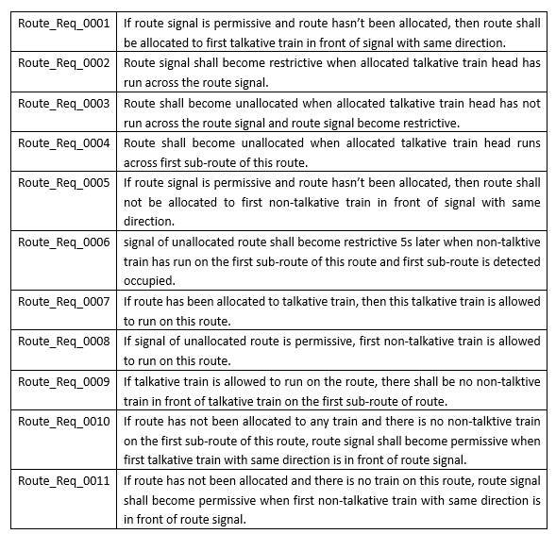
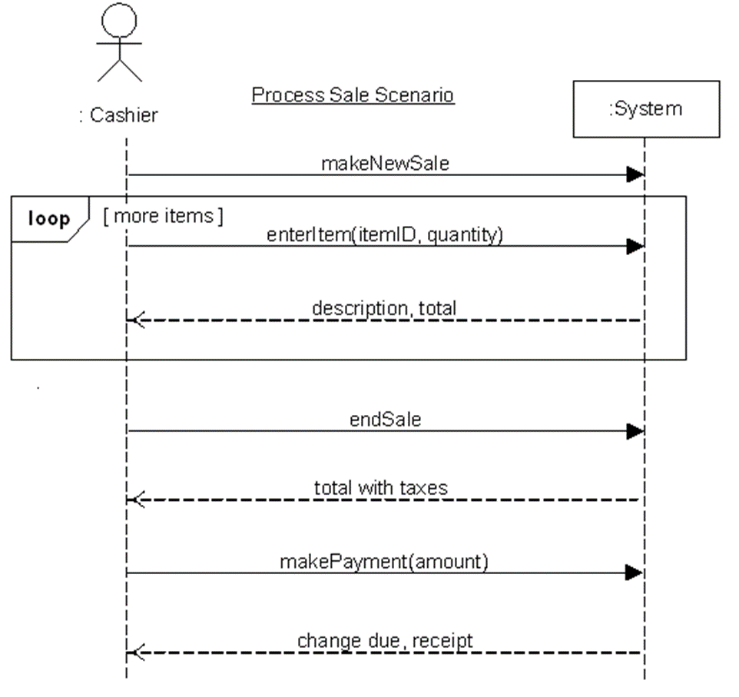
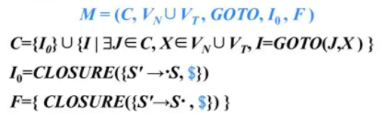
Software requirements
We can represent software requirements in several ways:
Documents that use well-structured and carefully written natural language
Graphical models that illustrate transformational processes, system states and changes between them, data relationships, logic flows, or object classes and their relationships
Formal specifications that define requirements using mathematically precise formal logic languages.
Natural language

Slide 7
The Software Requirements Specification
Labeling Requirements
Sequence Number
UR-1, UR-2
Hierarchical Numbering
3.2.1, 3.2.2
Hierarchical Textual Tags
Print.ConfirmCopies
Dealing with Incompleteness
To be determined, TBD
User Interfaces and the SRS

Slide 8
How many specifications?
Most projects create just one software requirements specification.
For large projects:
System requirements specification
Separate software requirements specification
Hardware requirements specification
Requirements management tool

Slide 9
如何写好SRS呢？
A Software Requirements Specification Template

Slide 10
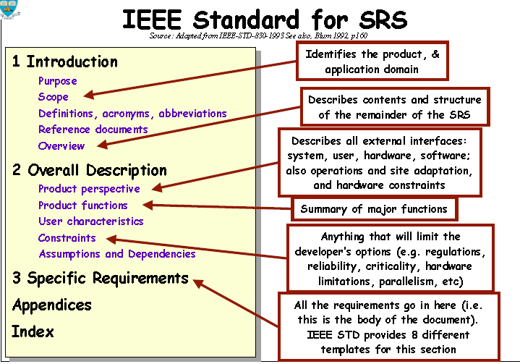

Slide 11
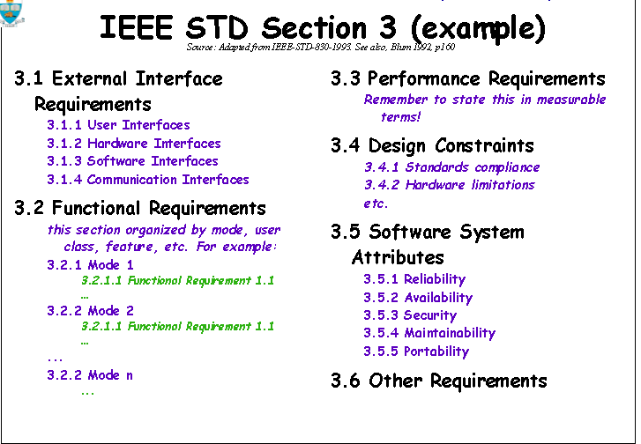

Slide 12
SRS Template adapted IEEE-830-1998
Introduction
Overall Description
Systems Features
External Interface Requirements
Other Nonfunctional Requirements
Other Requirements
Appendices
A – Glossary
B – Analysis Models
C – To-Be-Determined List
From requirements software, p.171-181
Notes:
Wiegers, pp. 152-162
引言引出对软件需求规格说明的概况,有助于读者理解该需求规格说明是如何编写的,应如何阅读和解释.
1.2 采用的标准或排版约定, 正文风格,提示区,或重要符号. 例如,说明高层需求的优先级是否可以被所有细化的需求所继承,或者每个需求成熟是否都有自身的优先级.
Perspective : product’s context and origin.

Slide 13
SRS Template adapted IEEE-830-1998
Developer, manager, sales, users, testers, writers
Introduction
1.1 Purpose
1.2 Document Conven-tions
1.3 Intended Audience
1.4 Product Scope
1.5 References
Overall Description
2.1 Product Perspective
2.2 Product Functions
2.3 User Classes and Characteristics
2.4 Operating Environment
2.5 Design and Implementation Constraints
2.6 Assumptions and Dependencies
DFD, use case, class diagram
Vision and scope document
Vision and scope document
From software requirements, p.171-181
Notes:
Wiegers, pp. 152-162
引言引出对软件需求规格说明的概况,有助于读者理解该需求规格说明是如何编写的,应如何阅读和解释.
1.2 采用的标准或排版约定, 正文风格,提示区,或重要符号. 例如,说明高层需求的优先级是否可以被所有细化的需求所继承,或者每个需求成熟是否都有自身的优先级.
Perspective : product’s context and origin.

Slide 14
SRS Template - 2
One possible way to arrange functional requirements
Systems Features
3.X System Feature X
3.X.1 Description and Priority
3.X.2 Stimulus/Response Sequences
3.X.3 Functional Requirements
External Interface Requirements
4.1 User Interfaces
4.2 Hardware Interfaces
4.3 Software Interfaces
4.4 Communications Interfaces
use case,
user class,
object class,
Functional hierarchy

Slide 15
SRS Template – 3
Other Nonfunctional Requirements
5.1 Performance Requirements
5.2 Safety Requirements
5.3 Security Requirements
5.4 Software Quality Attributes
Other Requirements
Appendices
A – Glossary
B – Analysis Models
C – To-Be-Determined Lists
Data flow diagram, class diagram, state transition diagram , entity relationship diagram

Slide 16
Examples about nonfunctional reqs.
5.1 Performance Requirements
Response time
“95 % of catalog database queries shall be completed within 3 seconds on a single-user 1.1-GHz Intel Pentium 4 PC running Microsoft Windows XP with at least 60% of the system resource free. ”
5.2 Safety Requirements
The system shall terminate any operation within 1 second if the measured tank pressure exceeds 95% of the specified maximum pressure.

Slide 17
Examples about nonfunctional reqs.
5.3 Security Requirements
Every user must change his initially assigned login password immediately after his first successful login. The initial password may never be used.
5.4 Software Quality Attributes
Availability : the system shall be at least 99.5% available on weekdays between 6:00 a.m. and midnight local time.
Efficiency, Robustness, usability, …

Slide 18
需求的模板可以根据项目定制
Recommended template

Slide 19
问题：
如果针对轨道交通系统，如何对模板进行裁剪？

Slide 20
Chapter 11. Writing excellent requirements

Slide 21
Characteristics of excellent requirements
Complete
Correct
Feasible
Necessary
Prioritized
Unambiguous
Verifiable

Slide 22
Complete
Each requirement must fully describe the functionality to be delivered.
It must contain all the information necessary for the developer to design and implement that bit of functionality.
To be determined (TBD) as a standard flag
Example:
The XML parser shall produce a markup error report that allows quick resolution of errors when used by XML novices.
Notes:
If you are lacking certain information

Slide 23
Correct
Each requirement must accurately describe the functionality to be built.
A software requirement that conflicts with its parents system requirement is not correct.
Feasible
It must be possible to implement each requirement within the known capabilities and limitations of the system and its operating environment.

Slide 24
Necessary
Each requirement should document a capability that the customers really need or one that’s required for conformance to an external system requirement or a standard.
Prioritized
Assign an implementation priority to each functional requirement, feature, or use case to indicate how essential it is to a particular product release.

Slide 25
Unambiguous
All readers of a requirement statement should arrive at a single, consistent, interpretation of it, but natural language is highly prone to ambiguity.
Example
The operator identifier is composed by a name and a password. The password is of 6 digital form. When the operator logins the system, it is stored in a registration file.

Slide 26
Verifiable
See whether you can devise a few tests or use other verification approaches, such as inspection or demonstration, to determine whether the product properly implements each requirement.
Example
The employee’s ID must within a valid range.

Slide 27
Requirements Specification Characteristics
Complete
No requirements or necessary information should be absent.
Consistent
Consistent requirements don’t conflict with other requirements of the same type or with higher-level business, system, or user requirements.
Modifiable
Traceable

Slide 28
Modifiable
You must be able to revise the SRS when necessary and to maintain a history of changes made to each requirement.
Traceable
A traceable requirement can be linked backward to its origin and forward to the design elements and source code that implement it and to the test cases that verity the implementation as correct.

Slide 29
Guidelines for writing SRS:
Keep sentences and paragraphs short
Use the active voice
Use “The system shall do something ” not “something shall happen”
Write complete sentences
Use terms consistently and defined in a glossary
State requirements in a consistent fashion
Reduce ambiguity; avoid vague subjective terms
Avoid comparative words, e.g. “improve, maximize”
Notes:
Wiegers, pp. 162-163

Slide 30
Sample Requirements, Before and After(*)
Complete
Correct
Feasible
Necessary
Prioritized
Unambiguous
Verifiable

Slide 31
Example 1 "The Background Task Manager shall provide status messages at regular intervals not less than every 60 seconds."
After
The Background Task Manager (BTM) shall display status messages in a designated area of the user interface.
The messages shall be updated every 60 plus or minus 10 seconds after background task processing begins.
The messages shall remain visible continuously.
Whenever communication with the background task process is possible, the BTM shall display the percent completed of the background task.
The BTM shall display a "Done" message when the background task is completed.
The BTM shall display a message if the background task has stalled.
Notes:
What are the status messages? Under what conditions and in what fashion are they provided to the user? If displayed, how long do they remain visible? The timing interval is not clear, and the word "every" just muddles the issue.

Slide 32
Example 2 "The XML Editor shall switch between displaying and hiding nonprinting characters instantaneously."
After
The user shall be able to toggle between displaying and hiding all XML tags in the document being edited with the activation of a specific triggering mechanism. The display shall change in 0.1 second or less.

Slide 33
Example 3 "The XML parser shall produce a markup error report that allows quick resolution of errors when used by XML novices."
After
After the XML Parser has completely parsed a file, it shall produce an error report that contains the line number and text of any XML errors found in the parsed file and a description of each error found.
If no parsing errors are found, the parser shall not produce an error report.

Slide 34
Example 4 "Charge numbers should be validated on line against the master corporate charge number list, if possible."
After
At the time the requester enters a charge number, the system shall validate the charge number against the master corporate charge number list. If the charge number is not found on the list, the system shall display an error message and shall not accept the order.

Slide 35
Example 5 "The editor shall not offer search and replace options that could have disastrous results."
After
The editor shall require the user to confirm global text changes, deletions, and insertions that could result in data loss.
The application shall provide a multilevel undo capability limited only by the system resources available to the application.

Slide 36
Example 6 "The device tester shall allow the user to easily connect additional components, including a pulse generator, a voltmeter, a capacitance meter, and custom probe cards."
After
The tester shall incorporate a USB port to allow the user to connect any measurement device that has a USB connection.
The USB port shall be installed on the front panel to permit a trained operator to connect a measurement device in 15 seconds or less.

Slide 37

Agree on the specification

Slide 38
Reference
http://tuffley.com/tcs20001.htm
http://www.cse.msu.edu/~cse870/IEEEXplore-SRS-template.pdf
http://www.howtodothings.com/how-to-write-a-software-requirements-specifications-srs-document
http://www.microtoolsinc.com/Howsrs.php

Slide 39
Homework-preparing
Write an SRS for your own example .
Deadline is pending.
After we finish and review our analysis model.

Slide 40
The end
Thank you!

